Slide 1

Calculator and Text Editor
Task - 3

Slide 2


Calculator and Text Editor
LMS Username | Name | Batch
2113a53234 | GURUSANKAR B | A53
2113a53214 | ANAND S | A53
2113a53228 | DINESH N | A53
2113a53245 | LOKESH RAJA M | A53
2113a53230 | DONAVALLI SHANMUKA SAI | A53

Slide 3


Task - 3
Create various Front End Programs
Draw and design a uniform front end code for calculator
Draw and design a interactive front end code for text-editor
Evaluation Metric:
100% Completion of the above tasks
Learning Outcome
Get to know about concepts of project bucketing
Knowing about various frontend development framework like angular, vue,react
Know about various react topics like components, props, state, life cycle etc.

Slide 4
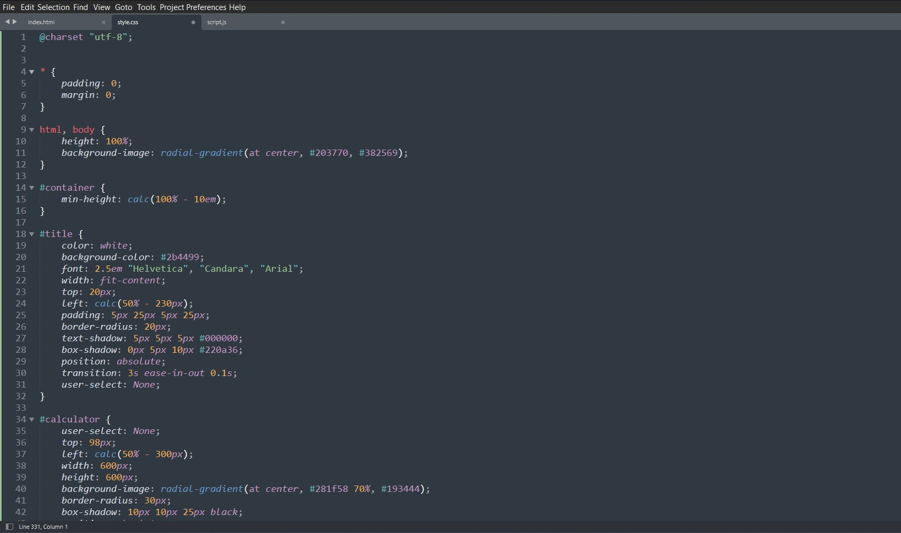
Code for Calculator

Slide 5
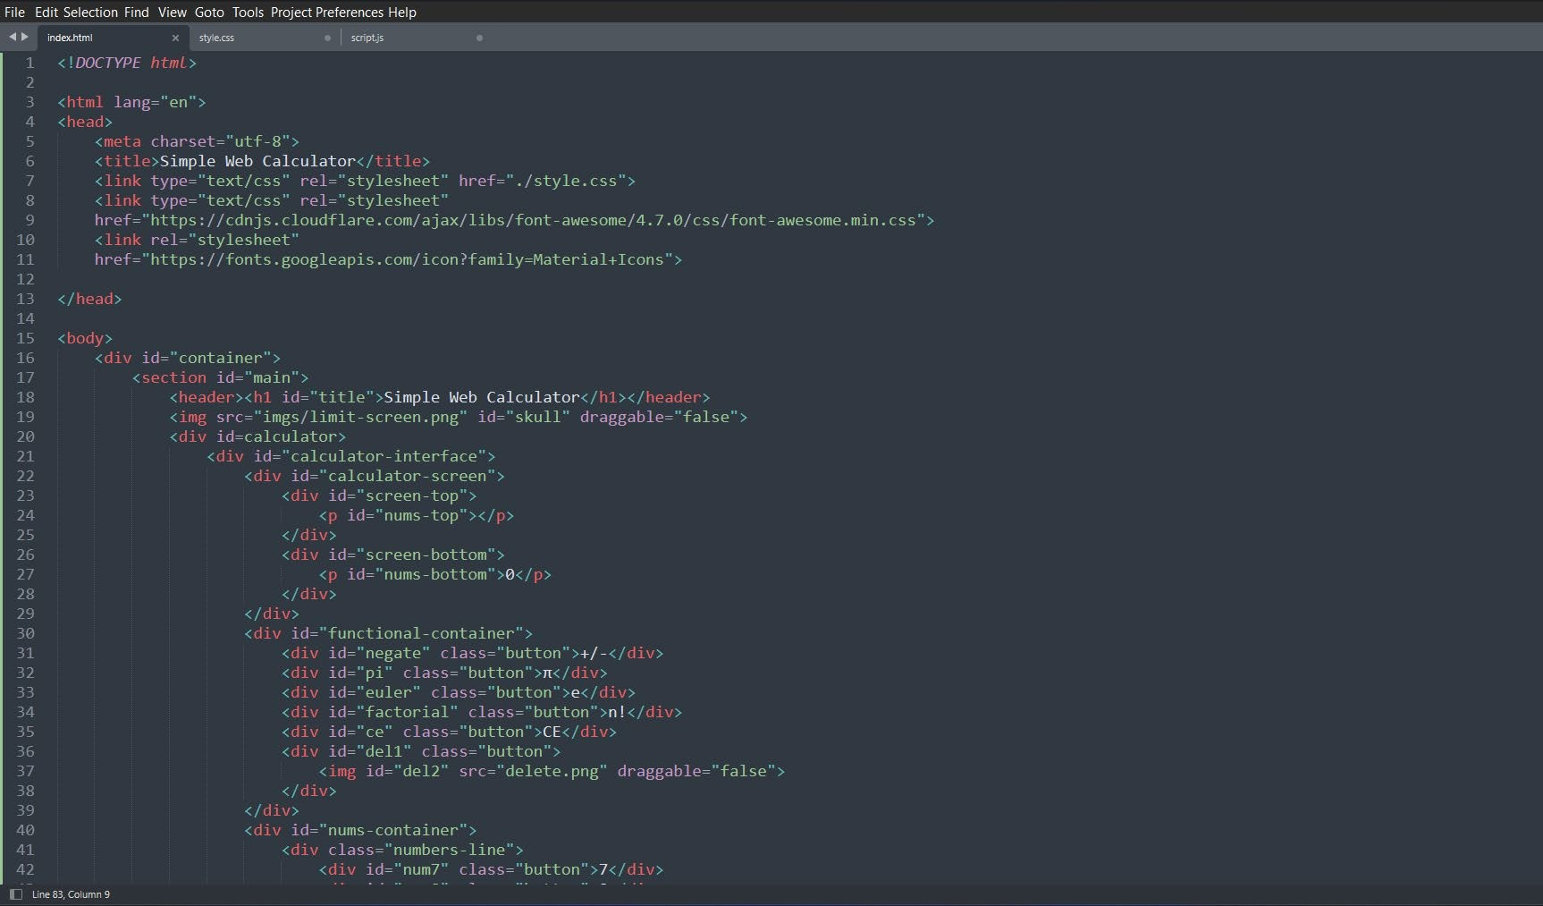

Slide 6
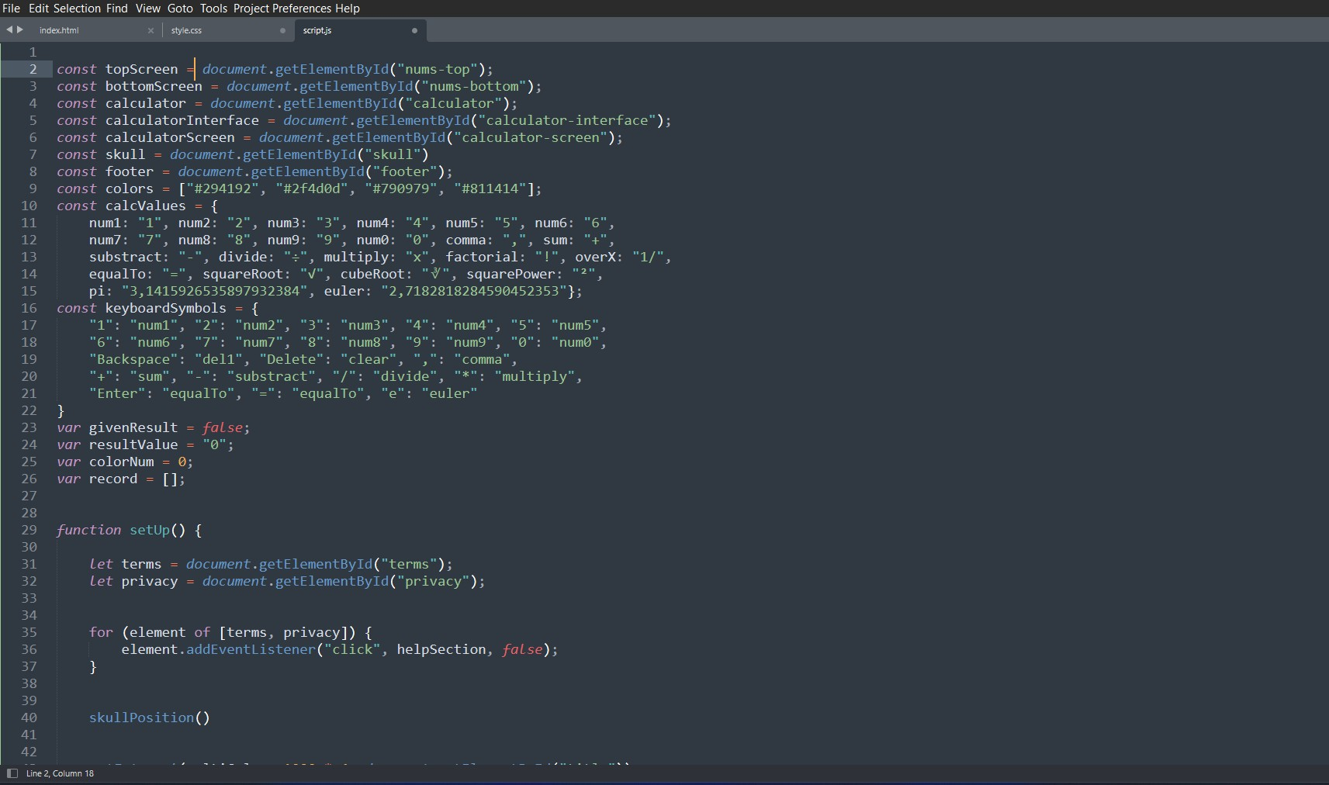

Slide 7
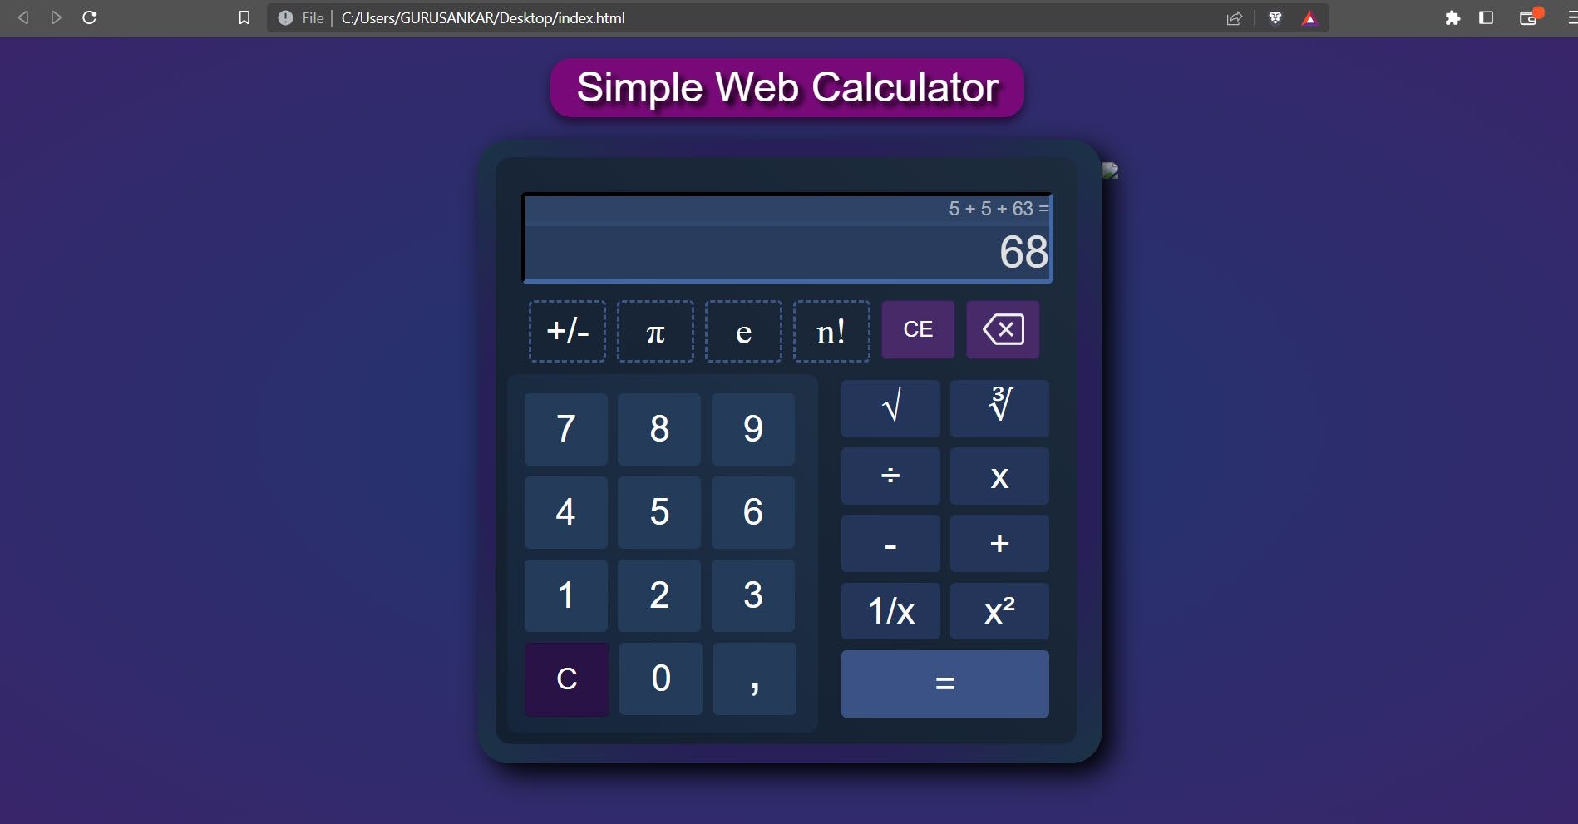
OUTPUT:

Slide 8
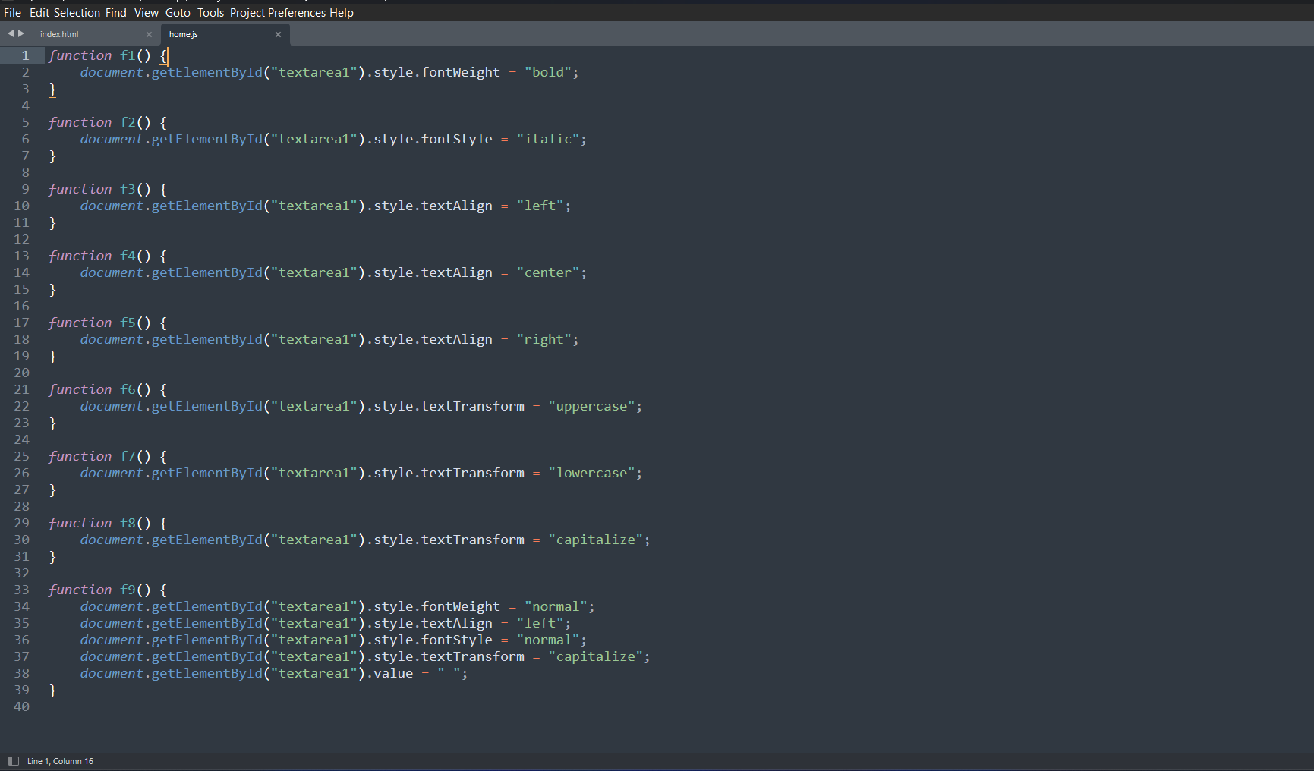
TEXT EDITOR CODE

Slide 9
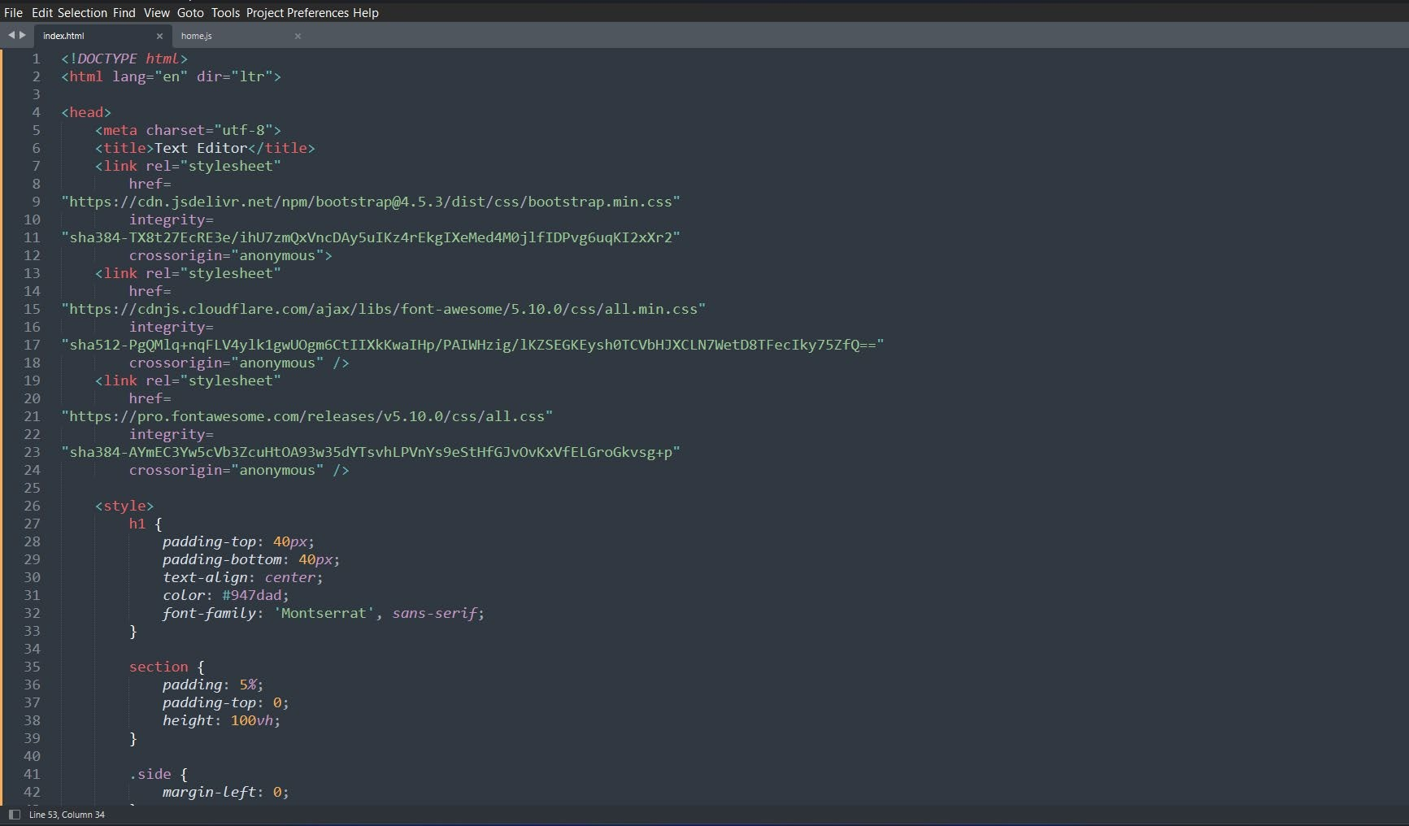

Slide 10
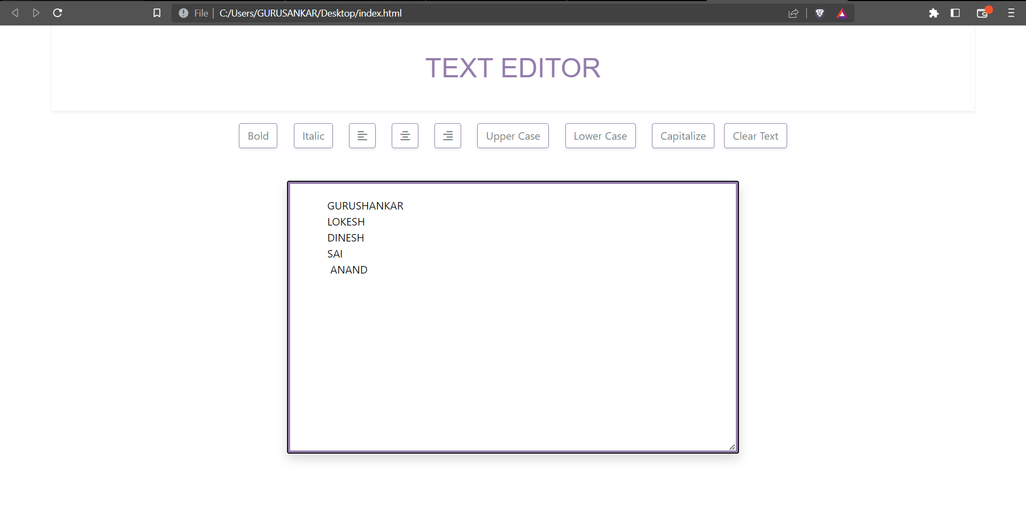
OUTPUT:

Slide 11


Assessment Parameter
Setup Project for Calculator
project
Setup basic structure of text- editor project
Create a main component with the outer structure of calculator
Check-List
Create main component with all feature buttons
Create a button component with on click handler
Create a json object to store data for text editor
Create a ` evaluateExpresion` function to evaluate value
Push both code to github

Slide 12
Submission Github
https://github.com/Lokeshrajarit/ Group_6_FSD_Batch_A53.git

Slide 13


